Slide 1
Media, HTTP, and Forms

Slide 2
Common HTML Attributes
Attributes add “metadata” to an element. They describe what the element is doing.
Some attributes are usable by every HTML element
id=“value”: used to give a unique ID to a single element
class=“value” : used to group elements for styling or scripting purposes. Can have multiple values separated by spaces
style=“key:value;” : used to set styling directly on an element. Can have multiple key:value pairs, separated by semicolons (;)
Id attribute emphasis
A tag, # href

Slide 3
The DOM
Document Object Model
HTML pages can be represented as trees, with elements and their content being branches or leaves.
Browsers render pages by performing tree traversal on the DOM.
JavaScript can manipulate a page’s DOM directly, causing the browser to redraw the page (and CSS styling to be reapplied based on the new state).

Slide 4
Document object/node
<!DOCTYPE html>
<html>
<head>
<title> My first page </title>
</head>
<body>
<p>content</p>
<br />
<p>content</p>
</body>
</html>
html
head
body
title
p
br
p
Relationships file
“My first page”
…
…

Slide 5
Absolute and Relative Paths
Your Computer
When structure can be represented as a tree, like a file system, you can express the location of something in that structure with a path.
Absolute: path is “measured” from a root or globally fixed point
C:\Programs\Web\helloWorld.html
Relative: measured from the location of another file or directory
../styles/stylesheet.css
C: Drive
Users
…
Cynthia
…
Desktop
…
SPARK
…
C:/Users/Cynthia/Desktop/SPARK
4

Slide 6
Media Best Practices
Unless it’s 1996, do not autoplay audio
Video should not autoplay either
Modern browsers do not allow for autoplay unless a video is muted
Always show video and audio controls, if possible
Images should have alt-text whenever possible
media

Slide 7
How the Internet Works
Browsers and servers generally do not keep open connections to each other.
Browser → Request → Server
Browser ← Response ← Server
Connection is closed
HTTP is a protocol. It defines how communication happens.
Other protocols: FTP, SMTP, HTTPS, Telnet
Browser sends HTTP request to URL.
HTTP request arrives at server.
Server finds requested resource (page, file, or program). Server may forward request to program
Server returns requested resource in HTTP response
Browser renders (draws) response to screen, or downloads file
Messages contain all info

Slide 8
Types of HTTP Request
Two flavors: GET and POST
Technically also PUT, DELETE, OPTION, and more, but these are only used by applications, not browsers.
Also called “HTTP methods”.
GET requests:
Used to “retrieve” data from the server
Parameters will be included in the URL after ‘?’
Whenever an HTTP request is generated from typing a URL into an address bar, or clicking a link, it’s a GET request.
URLs typically have a character limit depending on browser and server settings. Generally < 2000 characters is safe

Slide 9
Types of HTTP Request Cont.
POST requests:
Used to send data to a server
Parameters are only in the “body” of the request, do not appear in URL
Data is sent as key-value pairs
HTTP POST requests typically have a maximum size depending on the server configuration (~2-10 MB)
What if I need to send a bigger file?
Multipart POST requests: used to break data up across multiple requests to respect size limits.
Server must be configured to accept multipart requests.

Slide 10
HTML Forms and HTTP Methods
The method attribute of the <form> element determines the HTTP request used to send form data (GET or POST)
GET:
Form data will appear in the URL
http://website.com/destination?key1=value1;key2=...
Subject to URL length limits
DO NOT USE FOR CONFIDENTIAL INFORMATION
POST:
Form data will be in HTTP request body, and thus hidden
The name attribute of an <input> element becomes the name of the key for the value. The value attribute is the value of the input.

Slide 11
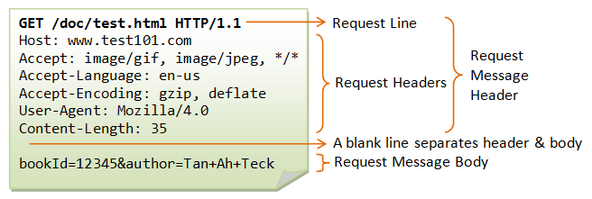
Structure of HTTP Requests
HTTP Requests have a head (filled with “headers”) and a body
Request Line: method, path, protocol
“Accept” headers: What types of data can be in the response. Restrictive. No match: no response/404.
Very descriptive

